Slide 1
Subsea Services Inc.
Website Development
Round 3 Comments
15 Sep 2016

Slide 2
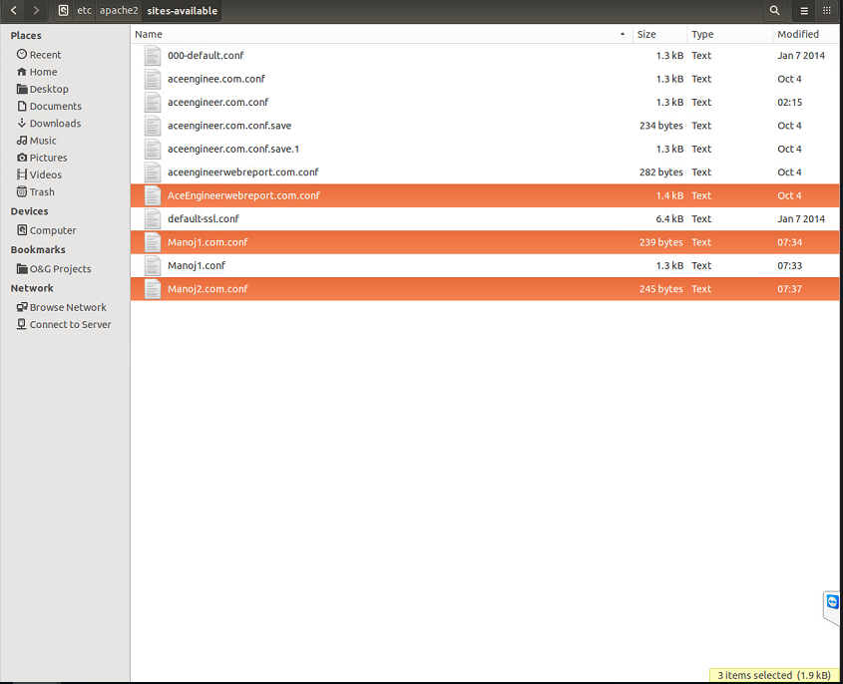
Website Name
In the terminal the warnings are given for only the highlighted files in below screenshot.
Please update the company name as GSY Update

Slide 3
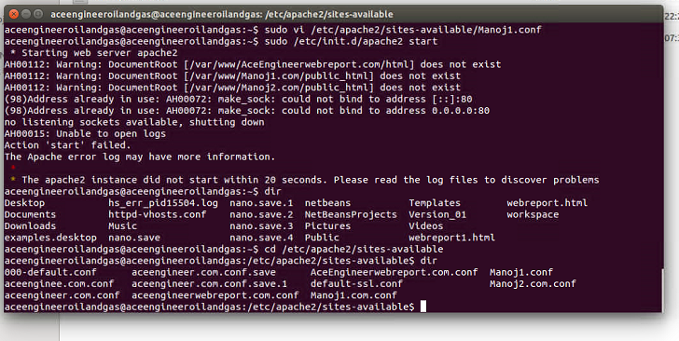
Website Name
Please update the company name as GSY Update

Slide 4
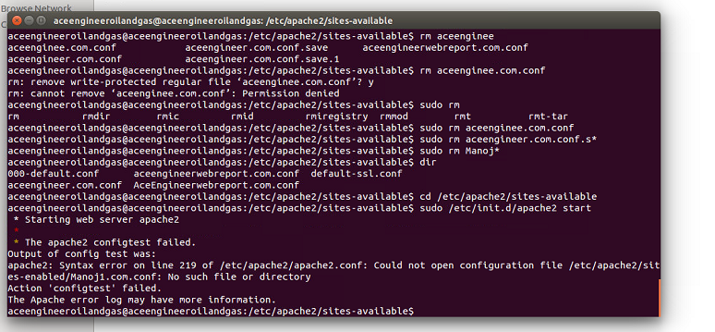
Website Name
Please update the company name as GSY Update

Slide 5
Website Name
Please update the company name as GSY Update

Slide 6
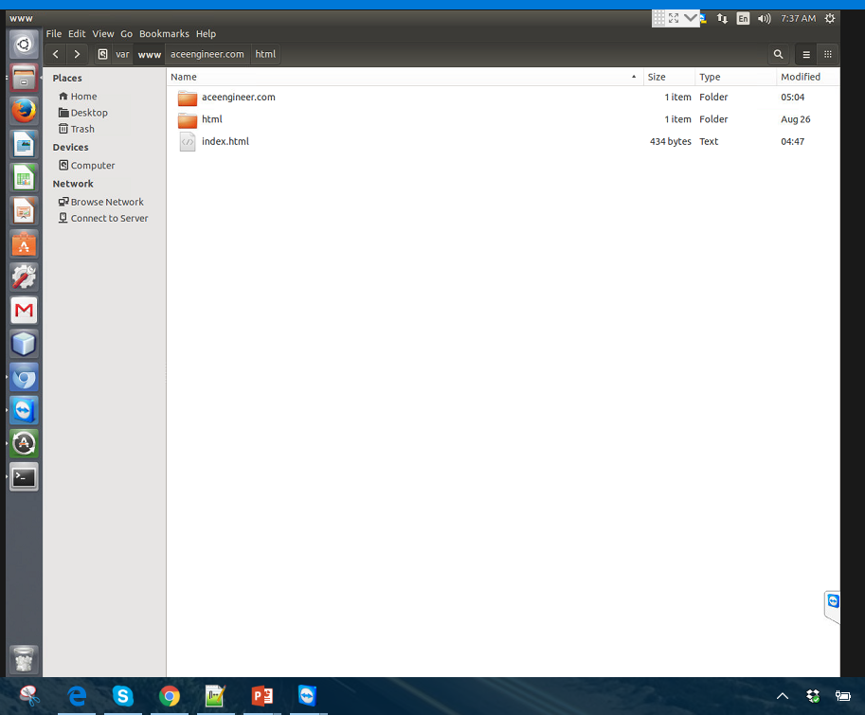
Website Name
Step One — Create the Directory Structure
We created the directory for the aceengineer.com with help of below code
sudo mkdir -p /var/www/aceengineer.com/html
Please update the company name as GSY Update

Slide 7
Website Name
Step Two — Grant Permissions
We given the permission for aceengineer.com with help of below code
sudo chown -R $aceengineeroilandgas:$aceengineeroilandgas /var/www/aceengineer.com/html
sudo chmod -R 755 /var/www
Please update the company name as GSY Update

Slide 8
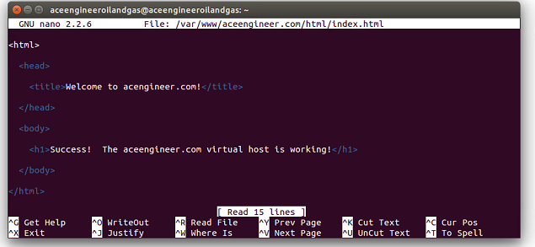
Website Name
Step Three — Create Demo Pages for Each Virtual Host
We wrote the below code for the demo page
nano /var/www/aceengineer.com/html/index.html
Please update the company name as GSY Update

Slide 9
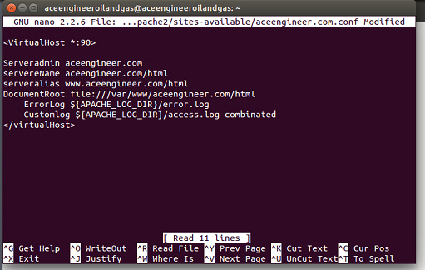
Website Name
Step Four — Create New Virtual Host Files
Virtual host files are the files that specify the actual configuration of our virtual hosts and dictate how the Apache web server will respond to various domain requests.
sudo cp /etc/apache2/sites-available/000-default.conf /etc/apache2/sites-available/aceengineer.com.conf
sudo nano /etc/apache2/sites-available/aceengineer.com.conf
Please update the company name as GSY Update

Slide 10
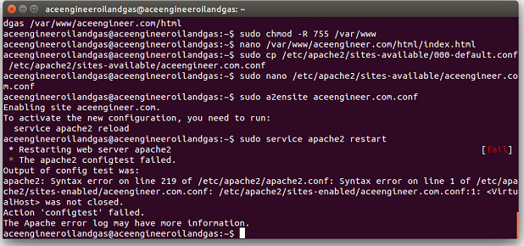
Website Name
Step Five — Enable the New Virtual Host Files
Now that we have created our virtual host files, we must enable them. Apache includes some tools that allow us to do this.
sudo a2ensite aceengineer.com.conf
While doing this step 5 we getting above highlited error.
Please update the company name as GSY Update

Slide 11
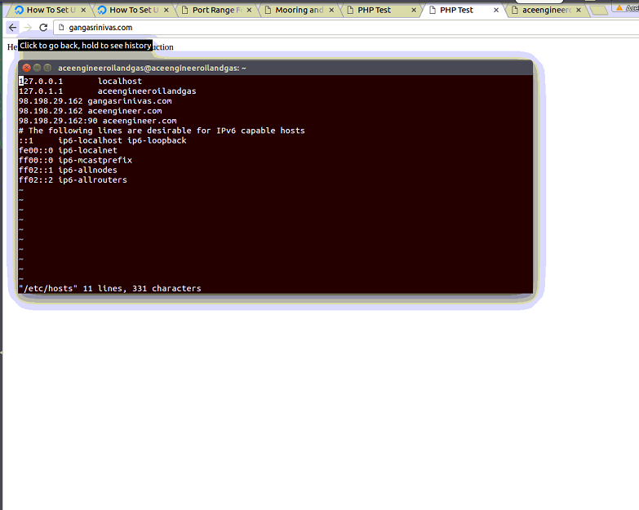
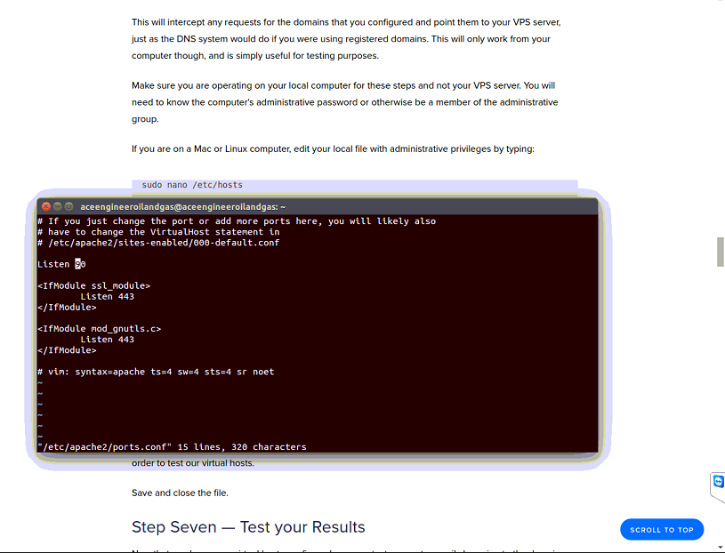
Website Name
Creating the port host with help below code
Sudo nano /etc/hosts
Please update the company name as GSY Update
Notes:
Etc/

Slide 12
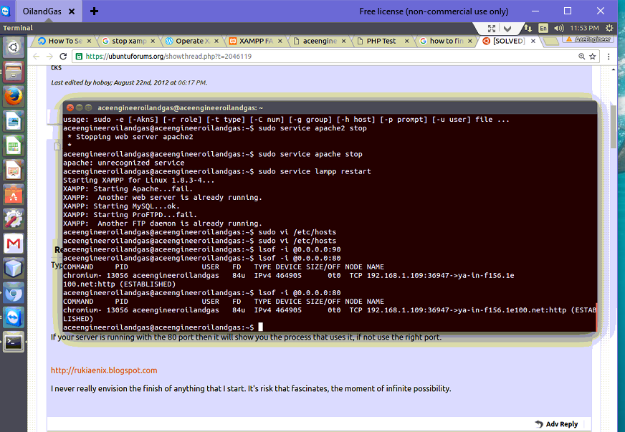
Website Name
Please update the company name as GSY Update
Notes:
Etc/

Slide 13
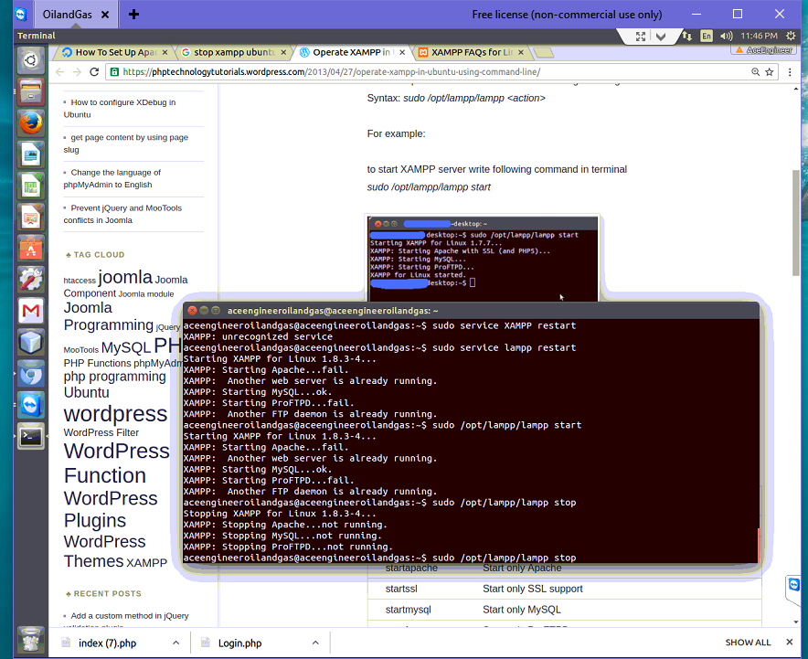
Website Name
For starting and stop lampp
Please update the company name as GSY Update
Notes:
Etc/

Slide 14
THANK YOU
For the opportunity to serve!

Slide 15
Document Revision History
01 | Round 2 comments. Round 1 comments in PRE-0006-01 | 12 Sept 2016 |  | GSY | VA
Rev | Description | Date |  | Author | Checked | Approved
Document No: |  |  | Client Ref:
0119-PRE-0007-01 |  |  | n/a

